Slide 1
Lesson 02.02 - Intro to Lists
Aim: How do we define data when we don't know how many items there are?
Notes:
Recurrsion without recursive structures
call it looping
all recursion is looping, not all looping is recursive
Review examples of base case and induction step
“Song that never ends”
not colors
numbers
russian dolls
mc esher
chain |anchor |link, chain
steps
conch shell
Hanging mobile

Slide 2
Review
Notes:
What questions should we be asking at this point?

Slide 3
Review
Midterm Question #14
Develop a function using a complete design recipe that when given the area of a square will calculate its perimeter.
Notes:
Many of you thought you needed to know a formula. What could you have done instead? Follow the design recipe. You don’t need to know the answer in order to solve a problem. You need to follow a problem solving process!

Slide 4
Review
Midterm Question #14
Develop a function using a complete design recipe that when given the area of a square will calculate its perimeter.
You don’t need to know the answer. You need to know the process!
Notes:
Many of you thought you needed to know a formula. What could you have done instead? Follow the design recipe. You don’t need to know the answer in order to solve a problem. You need to follow a problem solving process!

Slide 5
Review
# Header and Contract
fun sqr-perim(area :: Number) -> Number:
Notes:
Write a header with a contract.

Slide 6
Review
# Header and Contract
fun sqr-perim(area :: Number) -> Number:
doc: “Consumes an area of a square and produces the perimeter”
Notes:
Write a purpose statement

Slide 7
Review
# Header and Contract
fun sqr-perim(area :: Number) -> Number:
doc: “Consumes an area of a square and produces the perimeter”
where:
sqr-perim(4) is 8
end
2
4
2
Notes:
Write examples

Slide 8
Review
# Header and Contract
fun sqr-perim(area :: Number) -> Number:
doc: “Consumes an area of a square and produces the perimeter”
where:
sqr-perim(4) is 8
sqr-perim(25) is 5 * 4
end
5
5
25
Notes:
Write more examples

Slide 9
Review
# Header and Contract
fun sqr-perim(area :: Number) -> Number:
doc: “Consumes an area of a square and produces the perimeter”
num-sqrt(area) * 4
where:
sqr-perim(4) is 8
sqr-perim(25) is 5 * 4
end
square root of area
square root of area
area
Notes:
Write more examples

Slide 10
Review
What types of data have we worked with so far?

Slide 11
Review
What types of data have we worked with so far?
numbers, strings, images, booleans

Slide 12
Review
What types of data have we worked with so far?
numbers, strings, images, booleans
Atomic Data

Slide 13
Review
What types of data have we worked with so far?
numbers, strings, images, booleans
worlds, students, sneakers, boas, tigers, dillos, sneakers
Notes:
What did these data types have in common?

Slide 14
Review
What types of data have we worked with so far?
numbers, strings, images, booleans
worlds, students, sneakers, boas, tigers, dillos, sneakers
Compound Data

Slide 15
Review
What types of data have we worked with so far?
numbers, strings, images, booleans
worlds, students, sneakers, boas, tigers, dillos, sneakers
Atomic Data
Compound Data
Notes:
What do all of these types of data have in common?

Slide 16
Review
All the data we have worked with had an exact size.
numbers, strings, images, booleans
worlds, students, sneakers, boas, tigers, dillos, sneakers
Fixed Size Data

Slide 17
Functions with Fixed Size Data
We used a design recipe to write functions using fixed sized data. Now we’re going to learn to design functions using any size data!

Slide 18
Arbitrary Size Data
To represent data when we don’t know how many items there are.

Slide 19
Arbitrary Size Data
To represent data when we don’t know how many items there are.
Examples: contacts, playlists, online shopping carts, rapid fire projectiles

Slide 20
Arbitrary Size Data
Simplest arbitrary size data is a list

Slide 21
Arbitrary Size Data
Simplest arbitrary size data is a list
What is the most simple list?
Notes:
What is the most simple list?

Slide 22
Empty Lists
Simplest arbitrary size data is a list
The simplest list is empty
Notes:
Show empty in Pyret

Slide 23
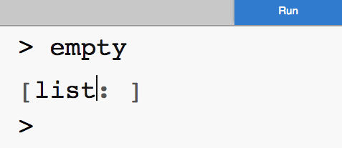
Empty Lists
empty is a value that stands for a list with nothing in it
Notes:
What is the next most simple list?

Slide 24
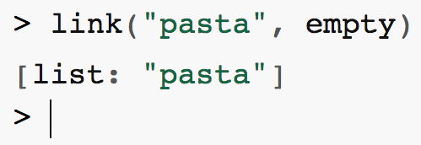
Lists are links of data
How to create a list of Mr. Allatta’s favorite foods
Notes:
What is the next most simple list?

Slide 25
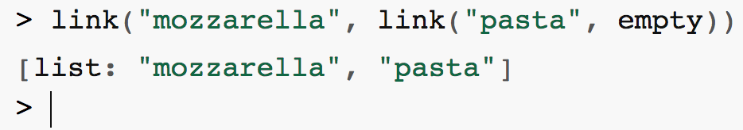
We can add as many things as we want
Let’s add one more
Notes:
What is the next most simple list?

Slide 26
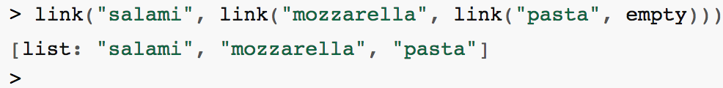
We can add as many things as we want
Links of links of links!
Notes:
What is the next most simple list?

Slide 27
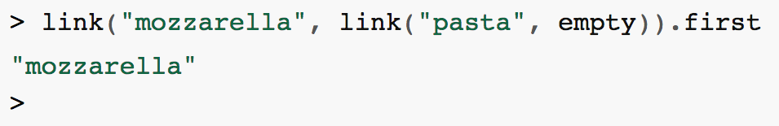
Getting items from a list
We can get the first item from the list
Notes:
What do you think this expression will return?

Slide 28
Getting items from a list
We can get the first item from the list
Notes:
What do you think this expression will return?

Slide 29
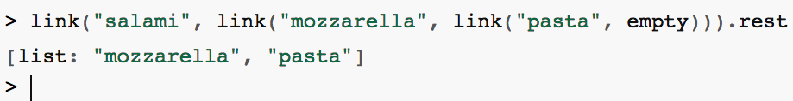
Getting items from a list
We can get the rest of the items from the list
Notes:
What do you think this expression will return?

Slide 30
Getting items from a list
We can get the rest of the items from the list
Notes:
What do you think this expression will return?

